Slide 1
Lesson 5
PHP Introduction

Slide 2
Introduction
Laravel is a web application framework with expressive, elegant syntax.
A web framework provides a structure and starting point for creating your application, allowing you to focus on creating something amazing while we sweat the details.

Slide 3






Case Tools

Slide 4
History of Laravel
In 2011, Codeigniter was the most popular framework used in php.
It was widely used as it was easy to learn and well documented.
Web developers created many projects by using the CodeIgniter framework, but it lacked certain essential features such as user authorization and authentication.
Taylor Otwell started the development of Laravel to provide an alternative of the Codeigniter framework.

Slide 5
Step 1:WAMP Installation
Download and install Bitnami WAMP serve

Slide 6
Step 2: Composer Installation
Composer is a dependency manager for a PHP programming language that manages the dependencies of PHP software and required libraries.
Nils Adermann and Jordi Boggiano developed the Composer. They started development in April 2011 and first it was released on March 1, 2012.
Composer runs through the command line. The main purpose of the composer is to install the dependencies or libraries for an application. The composer also provides the users to install the PHP applications available on the Packagist, where Packagist is the main repository that contains all the available packages.

Slide 7
Step 2: Composer Installation(cont.)
Composer runs through the command line.
The main purpose of the composer is to install the dependencies or libraries for an application.
The composer also provides the users to install the PHP applications available on the Packagist, where Packagist is the main repository that contains all the available packages.
Comoser Installation Link:Laravel | Composer Installation - Javatpoint

Slide 8
Step 2: Composer Installation(cont.)
Composer runs through the command line.
The main purpose of the composer is to install the dependencies or libraries for an application.
The composer also provides the users to install the PHP applications available on the Packagist, where Packagist is the main repository that contains all the available packages.

Slide 9
Laravel Root Directory
The most important directory which contains some other subdirectories.
Directory | Description
app | The app directory holds the base code for your Laravel application.
bootstrap | The bootstrap directory contains all the bootstrapping scripts used for your application.
config | The config directory holds all your project configuration files (.config).
database | The database directory holds your database files.
public | The public directory helps to start your Laravel project and maintains other necessary files such as JavaScript, CSS, and images of your project.
resources | The resources directory holds all the Sass files, language (localization) files, templates (if any).
routes | The routes directory contain all your definition files for routing, such as console.php, api.php, channels.php, etc.
storage | The storage directory holds your session files, cache, compiled templates as well as miscellaneous files generated by the framework.
test | The test directory holds all your test cases.
vendor | The vendor directory holds all composer dependency files.

Slide 10
The App Directory
The app directory contains the core code of your application. We'll explore this directory in more detail soon; however, almost all of the classes in your application will be in this directory.

Slide 11
The Bootstrap Directory
The bootstrap directory contains the app.php file which bootstraps the framework.
This directory also houses a cache directory which contains framework generated files for performance optimization such as the route and services cache files.
You should not typically need to modify any files within this directory.

Slide 12
The Config Directory
The config directory, as the name implies, contains all of your application's configuration files.
It's a great idea to read through all of these files and familiarize yourself with all of the options available to you.

Slide 13
The Database Directory
The database directory contains your database migrations, model factories, and seeds.
If you wish, you may also use this directory to hold an SQLite database.

Slide 14
The Public Directory
The public directory contains the index.php file, which is the entry point for all requests entering your application and configures autoloading.
This directory also houses your assets such as images, JavaScript, and CSS.

Slide 15
The Resources Directory
The resources directory contains your views as well as your raw, un-compiled assets such as CSS or JavaScript.
This directory also houses all of your language files.

Slide 16
The Routes Directory
The routes directory contains all of the route definitions for your application.
By default, several route files are included with Laravel:
web.php, api.php, console.php, and channels.php.

Slide 17
The Storage Directory
The storage directory contains your logs, compiled Blade templates, file based sessions, file caches, and other files generated by the framework.
This directory is segregated into app, framework, and logs directories.
The app directory may be used to store any files generated by your application.
The framework directory is used to store framework generated files and caches.
Finally, the logs directory contains your application's log files.

Slide 18
The Tests Directory
The tests directory contains your automated tests.
Example PHPUnit unit tests and feature tests are provided out of the box.
Each test class should be suffixed with the word Test. You may run your tests using the phpunit or php vendor/bin/phpunit commands.
Or, if you would like a more detailed and beautiful representation of your test results, you may run your tests using the php artisan test Artisan command.

Slide 19
The Vendor Directory
The vendor directory contains your Composer dependencies.

Slide 20
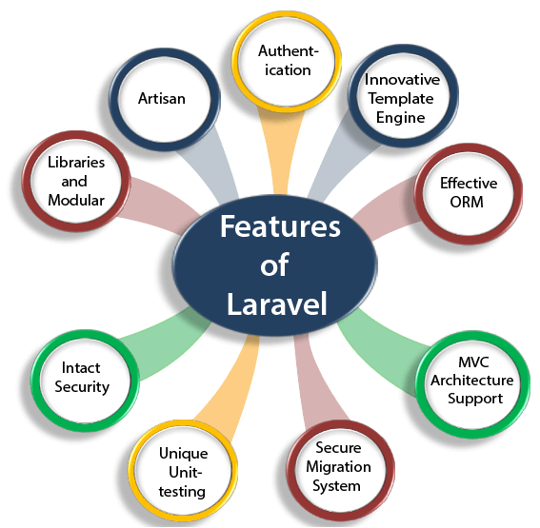
Features of Laravel

Slide 21
Authentication
Authentication is the most important factor in a web application, and developers need to spend a lot of time writing the authentication code.
Laravel makes a simpler authentication when Laravel is updated to Laravel 5.
Laravel contains an inbuilt authentication system, you only need to configure models, views, and controllers to make the application work..

Slide 22
Innovative Template Engine
Laravel provides an innovative template engine which allows the developers to create the dynamic website.
The available widgets in Laravel can be used to create solid structures for an application.

Slide 23
Effective ORM
Laravel contains an inbuilt ORM with easy PHP Active Record implementation.
An effective ORM allows the developers to query the database tables by using the simple PHP syntax without writing any SQL code.
It provides easy integration between the developers and database tables by giving each of the tables with their corresponding models.

Slide 24
MVC Architecture Support
Laravel supports MVC architecture. It provides faster development process as in MVC; one programmer can work on the view while other is working on the controller to create the business logic for the web application.
It provides multiple views for a model, and code duplication is also avoided as it separates the business logic from the presentation logic.

Slide 25
Secure Migration System
Laravel framework can expand the database without allowing the developers to put much effort every time to make changes, and the migration process of Laravel is very secure and full-proof.
In the whole process,PHP code is used rather than SQL code.

Slide 26
Unique Unit-testing
Laravel provides a unique unit-testing. Laravel framework can run several test cases to check whether the changes harm the web app or not.
In Laravel, developers can also write the test cases in their own code.

Slide 27
Intact Security
Application security is one of the most important factors in web application development.
While developing an application, a programmer needs to take effective ways to secure the application.
Laravel has an inbuilt web application security, i.e., it itself takes care of the security of an application.
It uses "Bcrypt Hashing Algorithm" to generate the salted password means that the password is saved as an encrypted password in a database, not in the form of a plain text.

Slide 28
Libraries and Modular
Laravel is very popular as some Object-oriented libraries, and pre-installed libraries are added in this framework, these pre-installed libraries are not added in other php frameworks.
One of the most popular libraries is an authentication library that contains some useful features such as password reset, monitoring active users, Bcrypt hashing, and CSRF protection.
This framework is divided into several modules that follow the php principles allowing the developers to build responsive and modular apps.

Slide 29
Artisan
Laravel framework provides a built-in tool for a command-line known as Artisan that performs the repetitive programming asks that do not allow the PHP developers to perform manually.
These artisans can also be used to create the skeleton code, database structure, and their migration, so it makes it easy to manage the database of the system.
It also generates the MVC files through the command line. Artisan also allows the developers to create their own commands.

Slide 30
The end Thank you

